Slide 1
Project Gladiator
Home Loan

Slide 2
Project Gladiator Team
Team Leader :
Konda Manisha (10702931)
Team Members :
Sai Lohith Varma Bhupathiraju (10702814)
Nishanth V (10702851)
Sumedh Kale(10703069)
Pooja Shinkar (10702819)

Slide 3
Introduction
Website & Home loan
Everyone in India dream’s to buy home, but due to insufficient balance the dream is not fulfilled…So here comes the Homely Bank Of India (HBI) which provides the home loan in just few steps & with less rate of interest.
To apply for the loan via conventional method is hectic & time consuming which the customer doesn't want & it was carried out per covid time, but now the bank’s website offers to the customer a good loan with less rate of interest @ 8.5% and with the contactless process.
The customer can avail the loan in few steps like
Register
Login
Apply For Loan
Check The Status Of Loan
Wait For Approval
Within a week

Slide 4
Project Abstract
Our project is a .NET web-based application which provides the facility of home loan to eligible Customers.
We provide a hassle-free user-friendly online platform to our users through which they can apply for loans based on their own requirements and keep a track of their status and record during the entire process of their loan approval.
We also provide features such as eligibility and EMI calculators through which users can get a rough estimate of the EMI and the loan amount, they are eligible for.

Slide 5
Technologies Used
The website has build from the scratch using .NET Technology with the help of Visual Studio 2019, Visual Studio Code 2019, MS SQL Server 2014 Management Studio.
The technologies is divided into two major parts as follows
Front End
(HTML, CSS, Typescript)
Back End
(Web-Api, MS SQL)

Slide 6
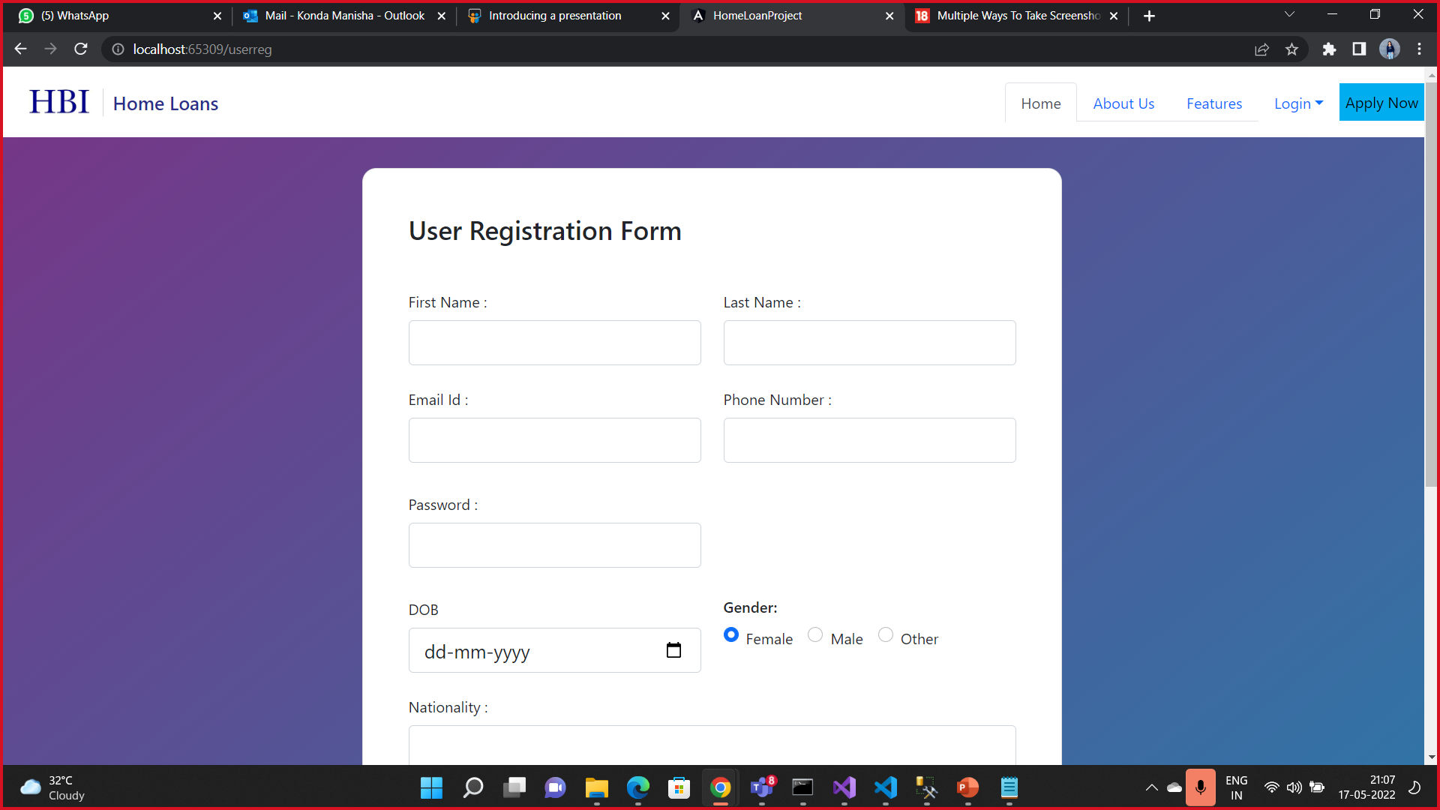
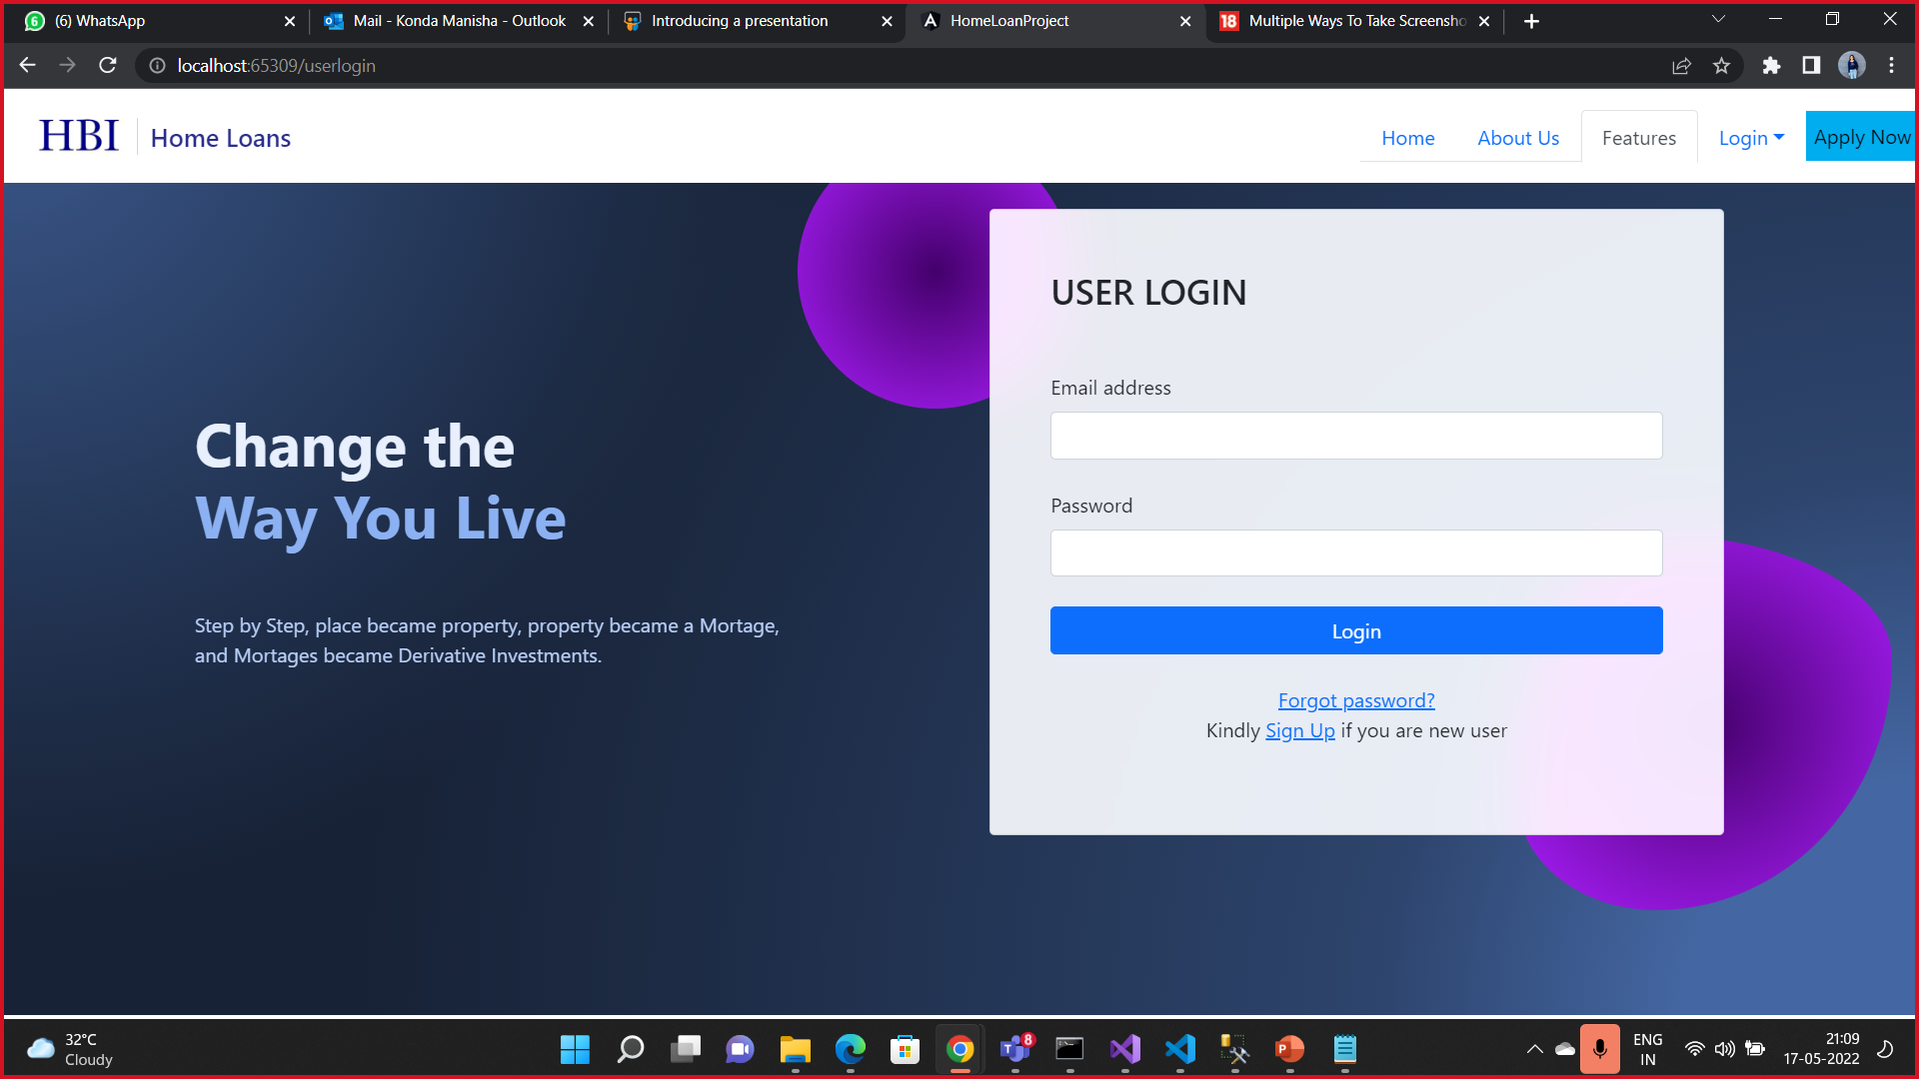
Homely Bank Of India (HBI) Website Snap Shorts
Registration & User Login Page

Slide 7
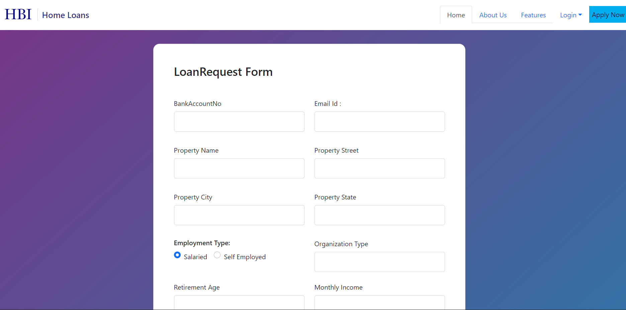
Homely Bank Of India (HBI) Website Snap Shorts
Loan request Page

Slide 8
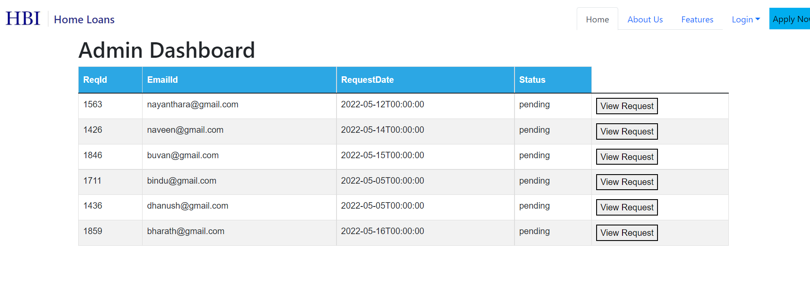
Homely Bank Of India (HBI) Website Snap Shorts
Dashboard Page

Slide 9
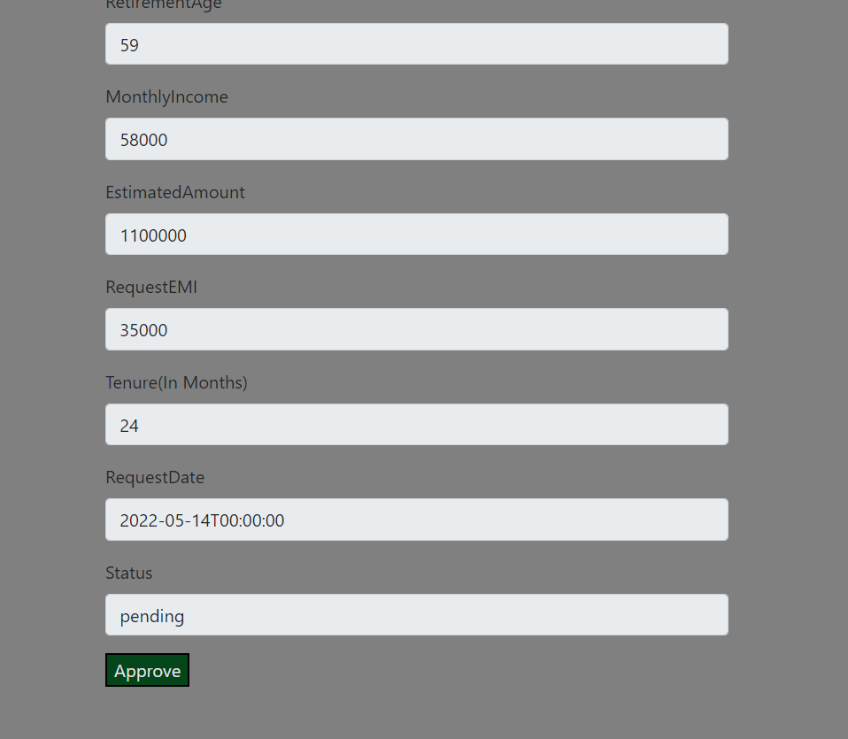
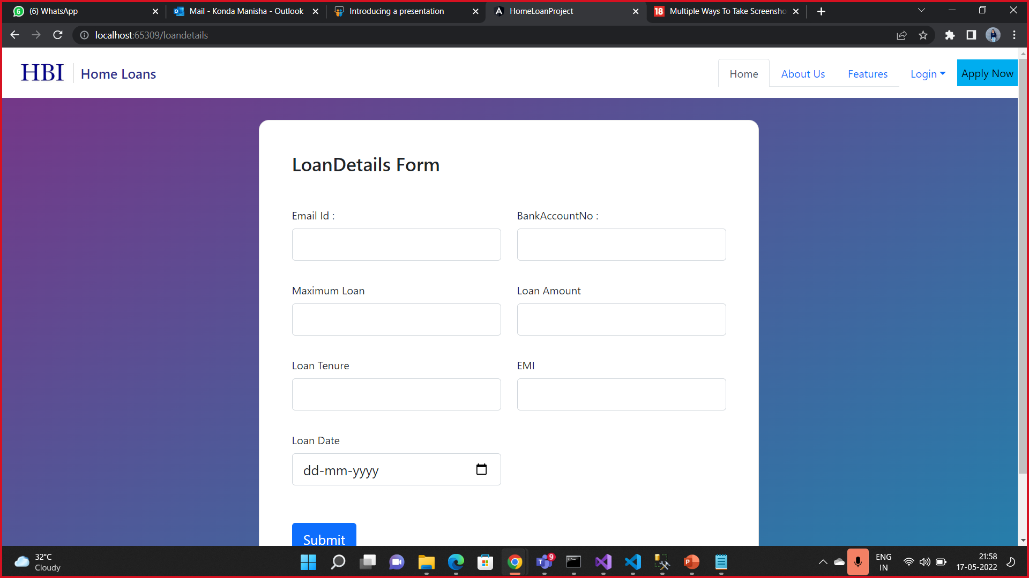
Homely Bank Of India (HBI) Website Snap Shorts
Loan Approval & Loan Details

Slide 10
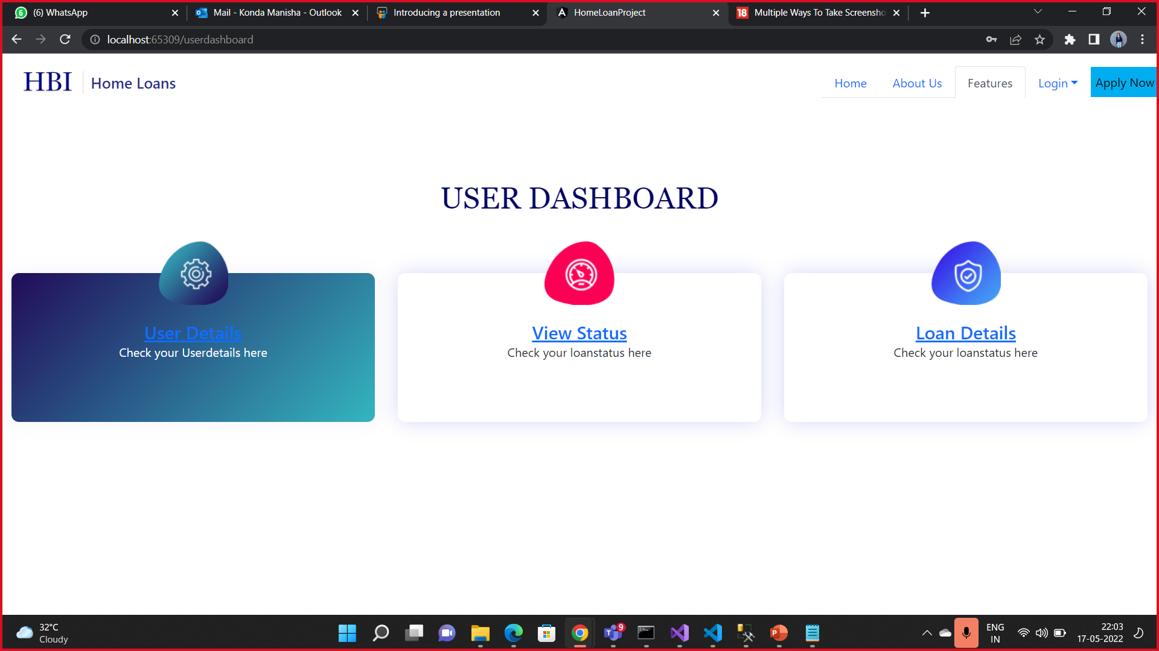
Homely Bank Of India (HBI) Website Snap Shorts
User Dashboard

Slide 11
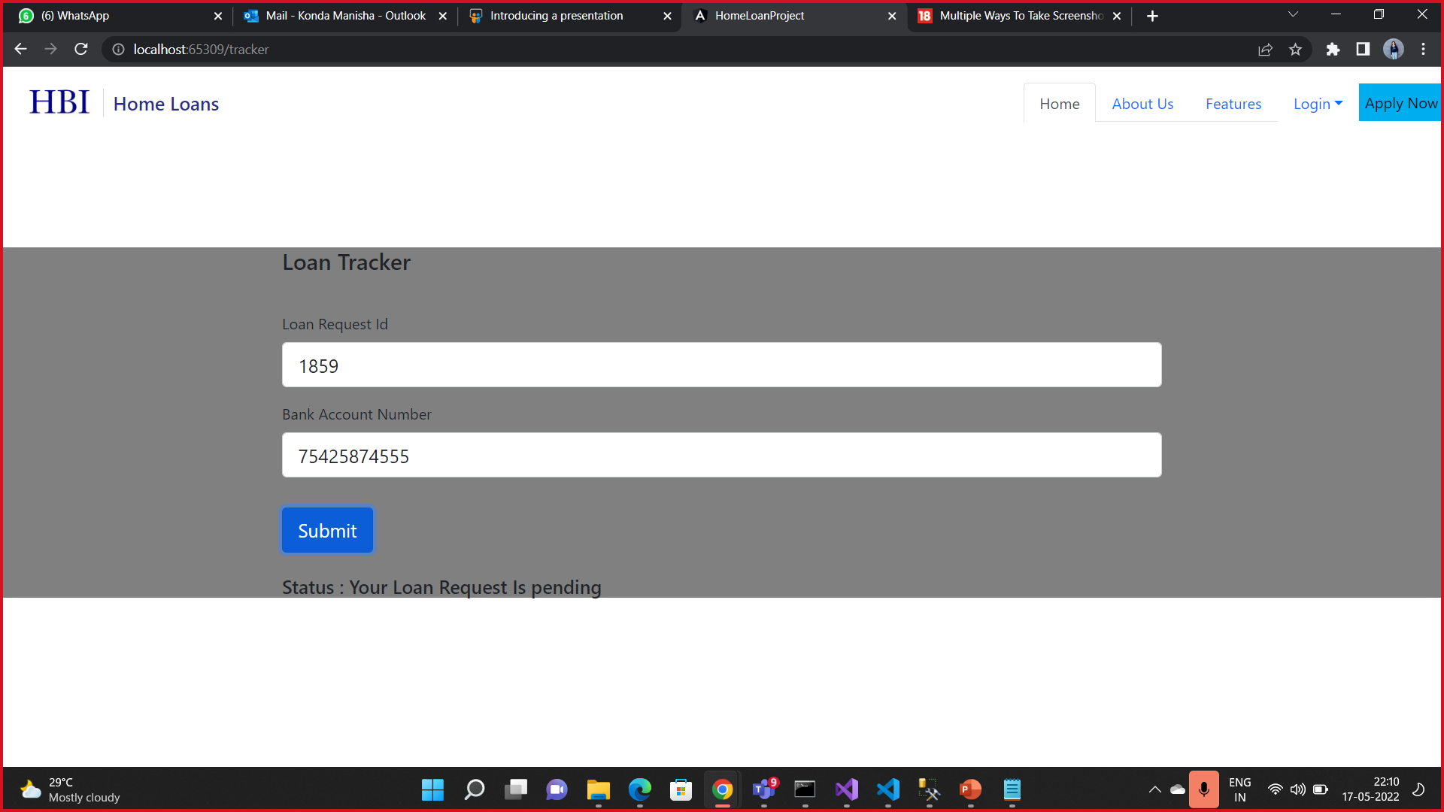
Homely Bank Of India (HBI) Website Snap Shorts
Loan Tracker

Slide 12
Advantages
The online home application provides various facilities to the customers as follows
Apply Easily
Time Saving
Contact Less Process
Avoid Long & Hectic Process
Flexibility and Versatility

Slide 13
Summary
Using visual studio code-2019 Angular we have developed the Web-Based Home Loan Application.
Using MS-SQL we have stored the User Details and Loan Details.
The Customer can avail Loan within few easy steps.
By connecting the Database to Web-Api we integrated the Code.
Customer can easily find Eligibility and EMI loan using Calculator

